Slide 1


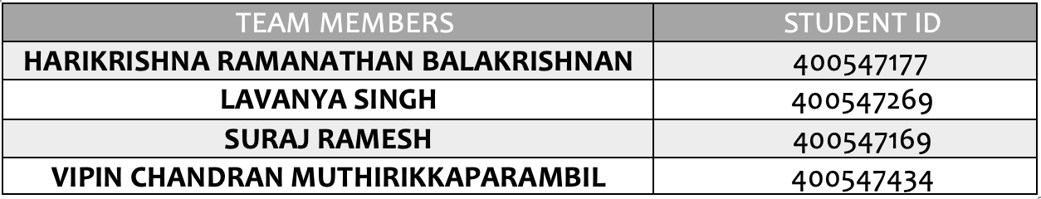
Comprehensive Life Expectancy Prediction System
using Multiple Linear Regression
GROUP NUMBER: 6 PROJECT PRESENTATION
SEP 786 – ARTIFICIAL INTELLIGENCE AND MACHINE LEARNING FUNDAMENTALS

Slide 2
DATA SOURCE
https://www.who.int/
https://www.kaggle.com
https://data.wordbank.org
The data employed in this analysis focuses on life expectancy and diverse health factors across 193 countries, extracted from the World Health Organization (WHO) data repository.
Corresponding economic data for these nations was also obtained from the United Nations website. The study is specifically centered on the years 2000 to 2015, with the goal of conducting thorough analyses related to economic indicators, mortality rates, and various health metrics across all 193 countries encompassed in the dataset.

Slide 3
INTRODUCTION
Life expectancy stands as a pivotal statistical metric, representing the average duration a human being is anticipated to live. This project focuses on understanding and analysing the multifaceted factors that significantly impact global life expectancy rate.
The chosen predictors are categorized into Immunization-related factors, Mortality factors, Economical factors, and Social factors. By utilizing this model, countries can identify specific factors contributing to lower life expectancy within their populations.
This insight becomes instrumental in tailoring evidence-based public health policies, precision medical interventions, and targeted social programs. The aim is to empower countries with the knowledge needed to strategically focus on areas that will most effectively enhance the life expectancy of their citizens.

Slide 4
PROPOSED SOLUTION
The proposed solution is to build a ‘Multiple Linear Regression model’ to predict the “Global General Life Expectancy” based on predicting variables divided into several broad categories:​ ​Immunization related factors, Mortality factors, Economical factors and Social factors.
This will help in suggesting a country in which evidence-based public health policies, precision medical interventions, and targeted social programs should be given importance in order to efficiently improve the life expectancy of its population.
The proposed solution also aims at creating a web app interface which will helps users/organizations to predict the future life expectancy of countries just by entering the parameters on which the model is trained.

Slide 5
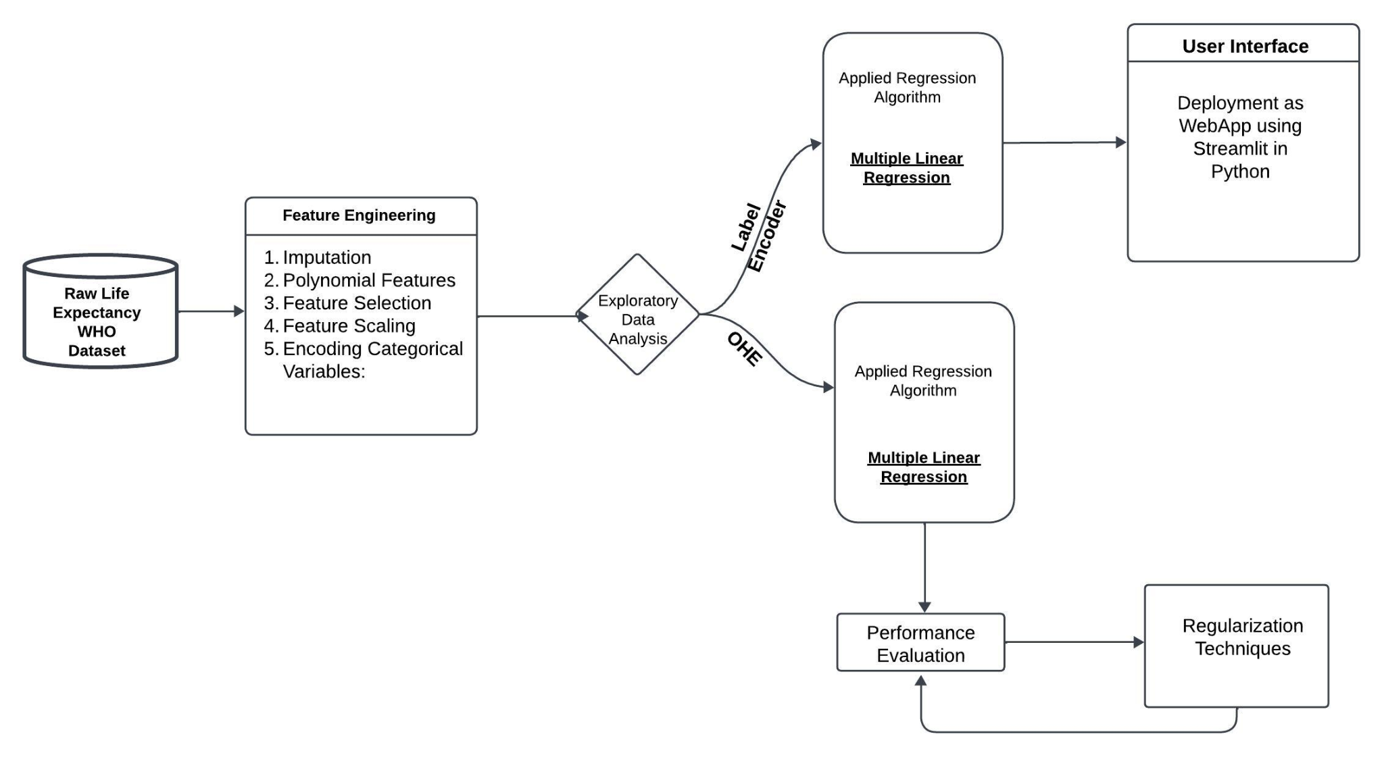
METHODOLOGY - WORKFLOW

Slide 6
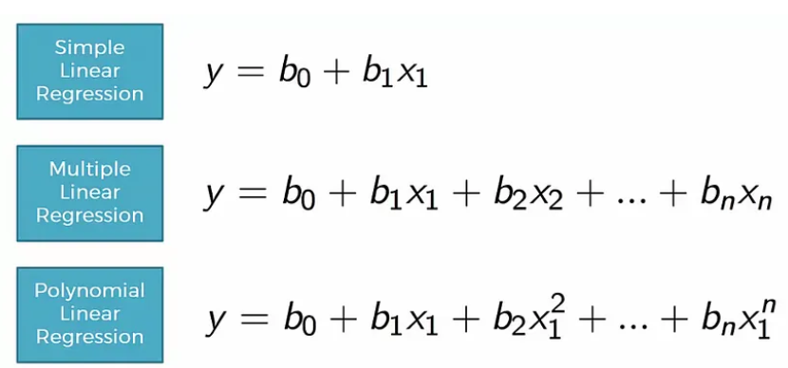
MULTIPLE LINEAR REGRESSION

Slide 7
RESULTS - Evaluation Metrics
R2 Score
Mean Absolute Error (MAE)
Mean Squared Error (MSE)
Root Mean Squared Error (RMSE)
1.3602491421990355
5.868228394132838
2.4224426503289687
0.937132872230424
1
2
3
4
Includes the Evaluation metrics for Respective Regularization Techniques also.

Slide 8
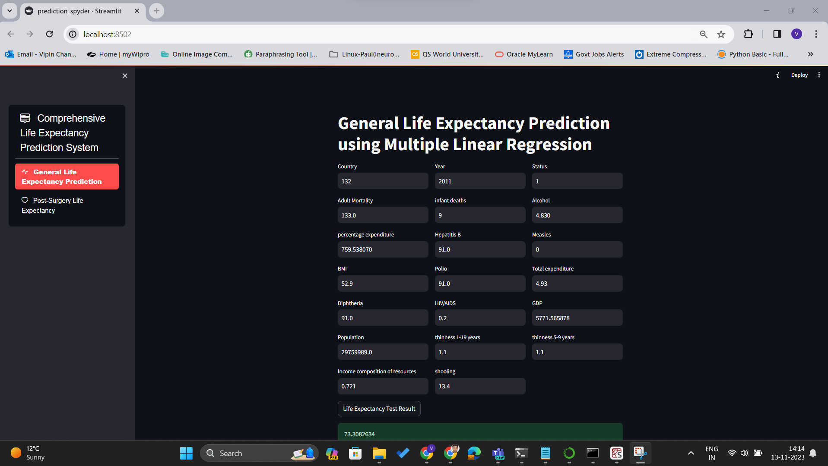
Model Deployment as WebApp

Slide 9
Group Member Contributions
Name of the Group Member | Task Description
Lavanya Singh (400547269) | Data Collection / Dealing with Missing Values and Outliers
Harikrishna Ramanathan Balakrishnan (40547177) | Dealing with Categorical Data / Web App Interface using StreamLit
Suraj Ramesh (400547169) | Exploratory Data Analysis / Web App Interface using StreamLit
Vipin Chandran Muthirikkaparambil (400547437) | Model Construction & Evaluation Metrics / Regularization Techniques

Slide 10

THANK YOU

